Slide 1
Science of Living System (BS20001)
SOUMYA DE
Office: 2nd Floor, Diamond Jubilee Building
Phone: 03222-2284552
E-mail: somde@iitkgp.ac.in
Website: http://iitkgpbioscience.weebly.com/soumya-de.html
Research interests:
Biophysics
Nuclear Magnetic Resonance (NMR) Spectroscopy
Protein Engineering
Signal Transduction and Gene Expression
Enzymology

Slide 2
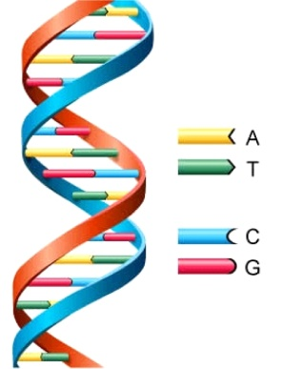
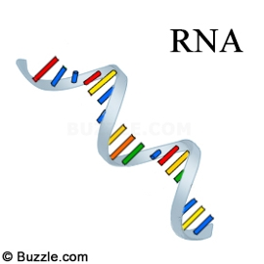
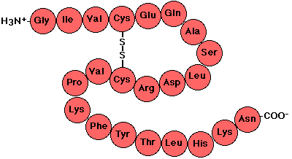
Central Dogma of molecular biology
DNA: Storage Medium
Polymer of nucleotides
CCTGAGCCAACTATTGATGAA
RNA: Transmission Medium
Polymer of nucleotides
CCUGAGCCAACUAUUGAUGAA
Protein: Molecular Machines
Polymer of amino acids
PEPTIDE

Slide 3
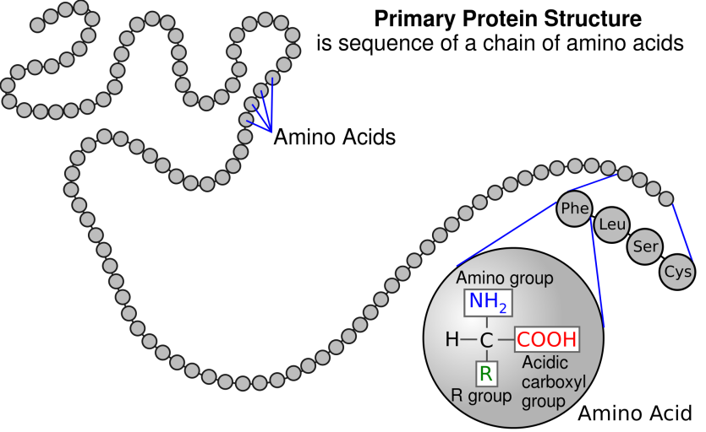
Primary Structure of Proteins
The primary structure of a protein is its amino acid sequence

Slide 4
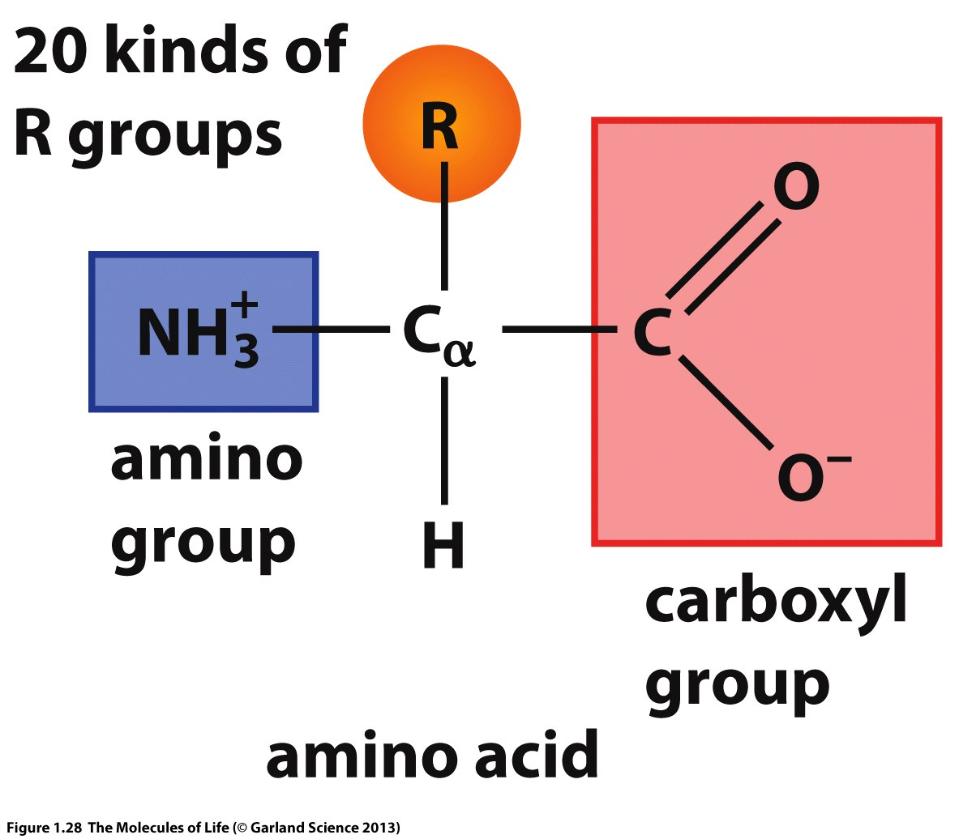
Amino acids: Building blocks of Proteins
Protein is a polymer of amino acids.
There are 20 common amino acids.
Amino acids have a common chemical structure - A tetrahedral sp³ carbon (C_{α}) with four different functional groups:
Amino group
Carboxyl group
H-atom
Side chain (R) with distinct chemical property

Slide 5
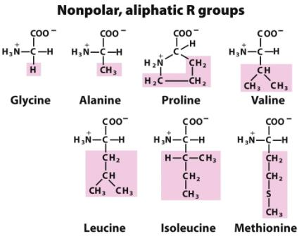
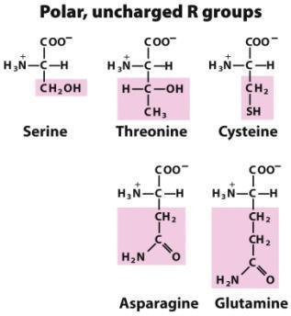
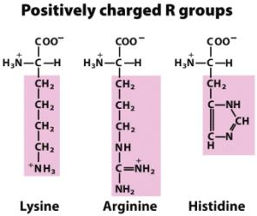
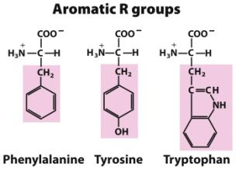
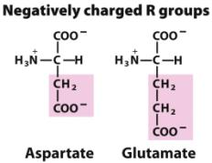
The 20 Common Amino Acids of Proteins

Slide 6
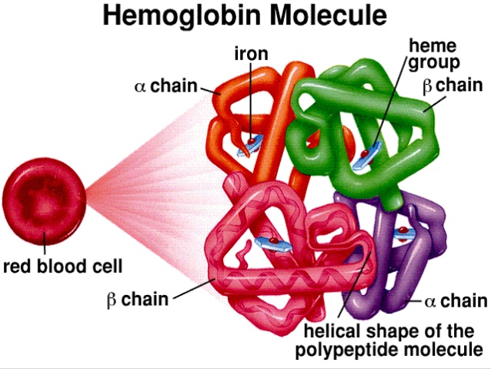
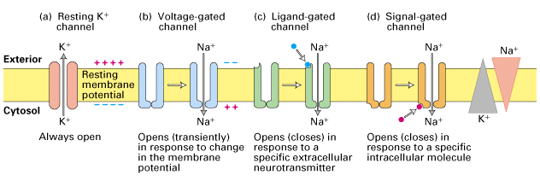
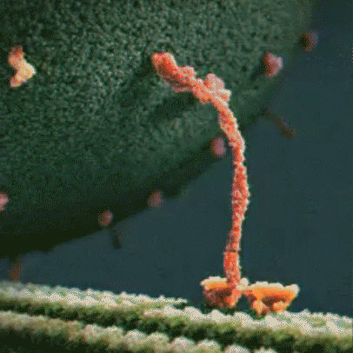
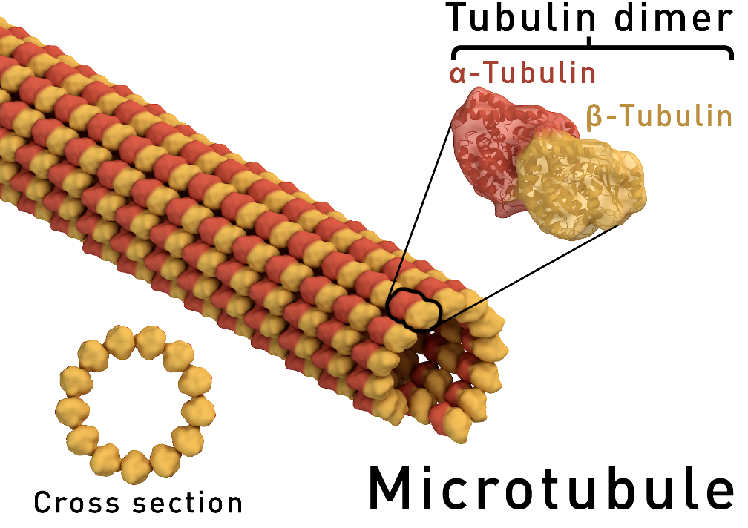
Proteins come in various shapes and sizes

Slide 7
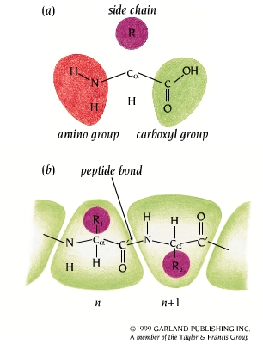
Proteins are polypeptide chains Successive polypeptide bonds: main chain or backbone

Slide 8
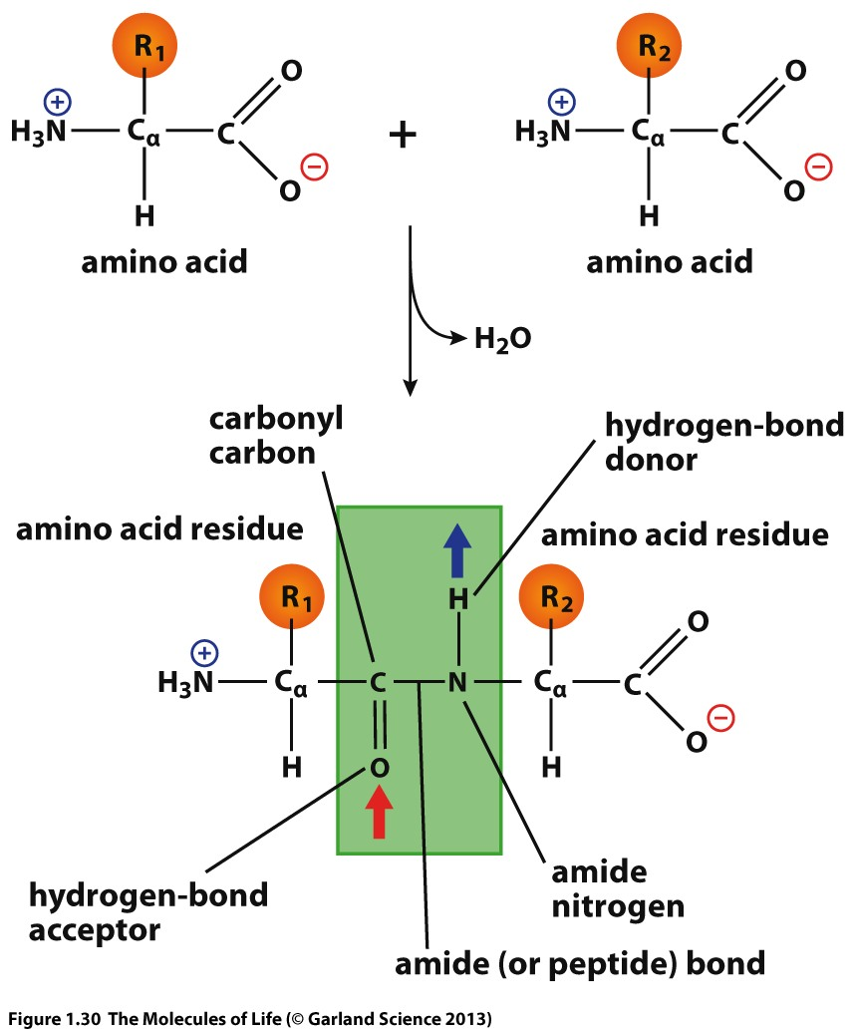
Formation of the peptide bond

Slide 9
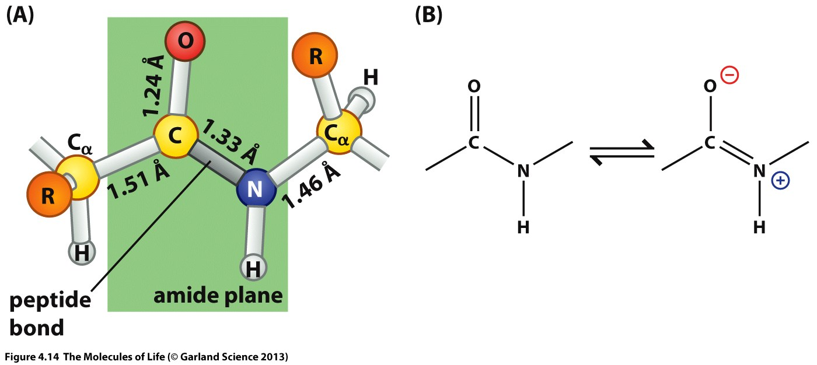
The amide plane: partial double bond character of the peptide bond

Slide 10
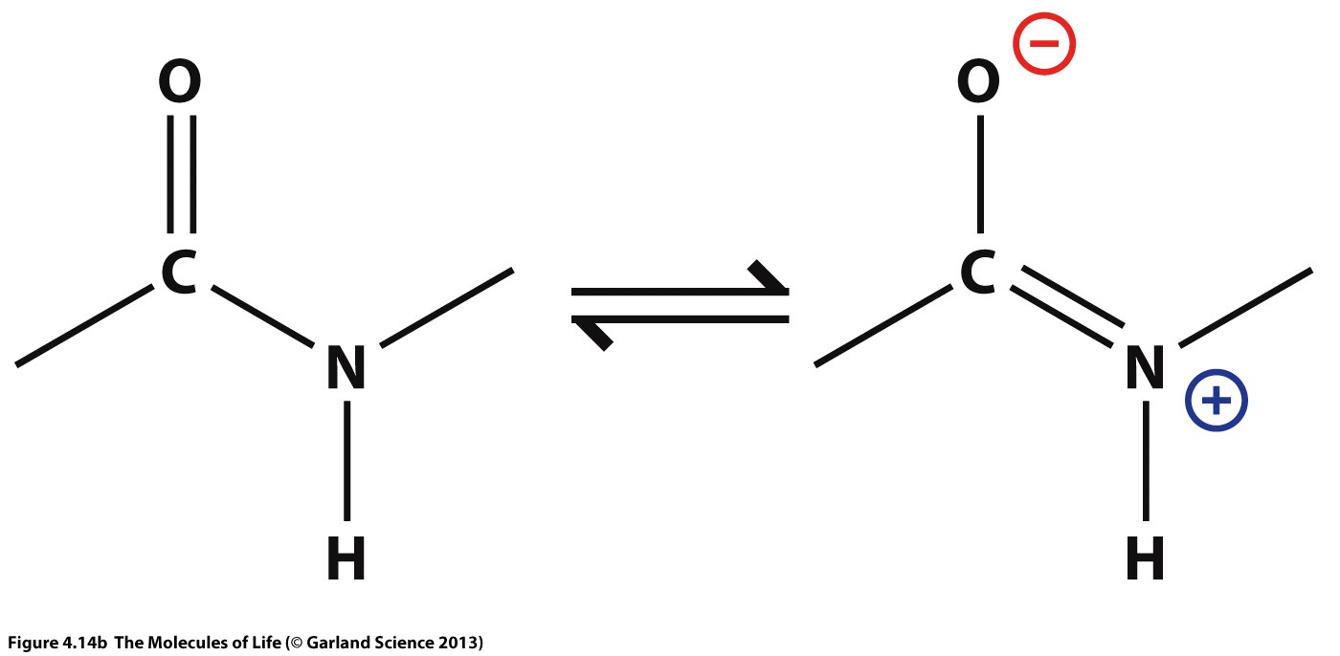
C_{α}
C_{α}
C_{α}
C_{α}
TRANS
H
H
C_{α}
C_{α}
CIS
C_{α}
C_{α}

Slide 11
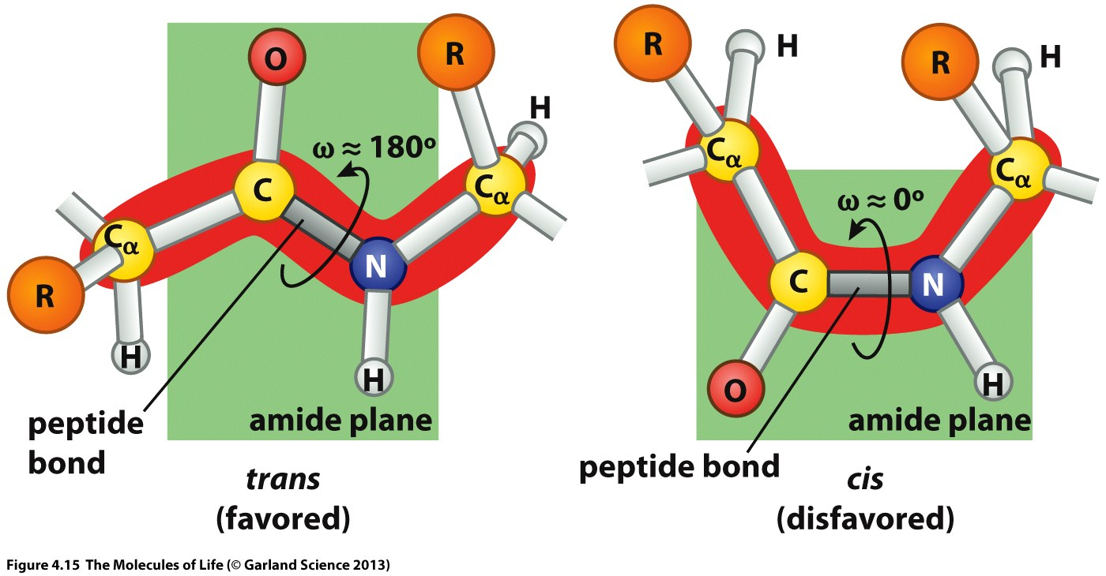

Slide 12
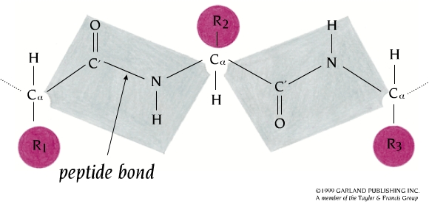
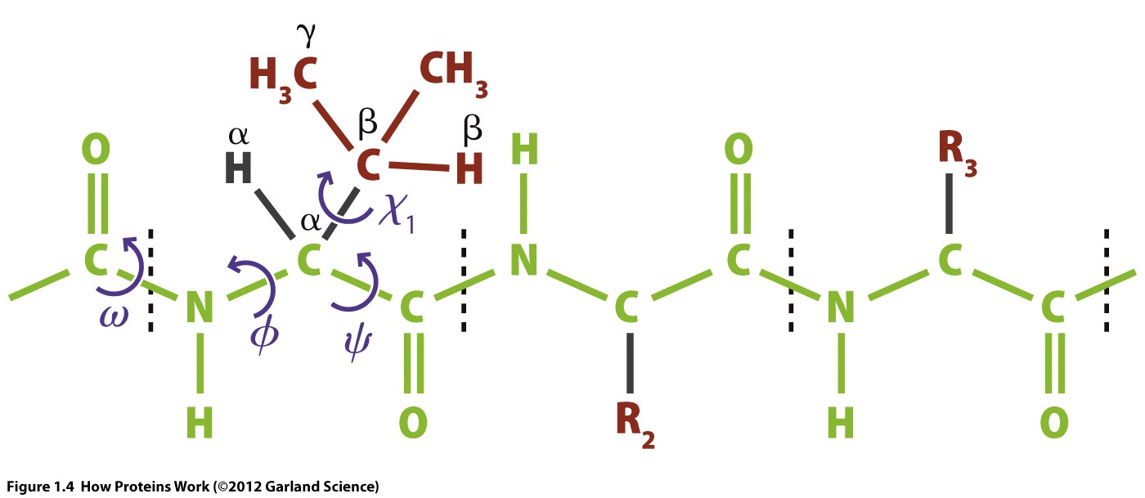
Torsion angles: Φ (phi) and Ψ (psi)
Peptide Plane

Slide 13
Visualizing a few torsion angles
Front
Back
1
4
4 (behind 1)
1
2
3
2
3 (behind 2)

Slide 14
Visualizing a few torsion angles
4
1
Front
Back
4
1
0°
2
3
2
3
1
1
Front
Back
4
4
Atom 4 is above the plane of the board
+45°
2
3

Slide 15
Visualizing a few torsion angles
1
1
Front
Back
4
4
Atom 4 is below the plane of the board
-45°
2
3
1
1
Front
Back
Atom 4 is below the plane of the board
-135°
2
3
4
4

Slide 16
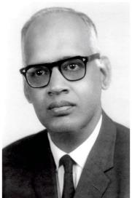
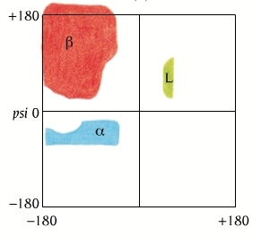
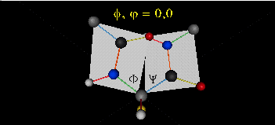
Ramachandran Plot
G. N. Ramachandran
Φ
Ψ
ω
Ψ (psi)
Φ (phi)

Slide 17
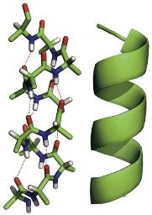
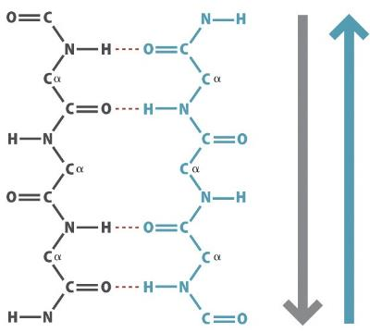
Ramachandran Plot
α-Helix
β-Strand
Ψ (psi)
Φ (phi)

Slide 18
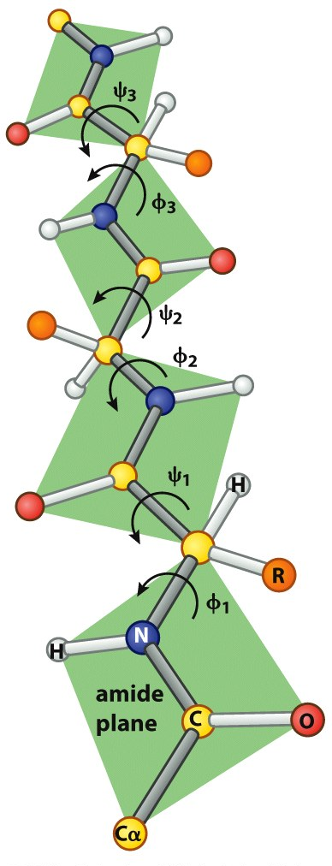
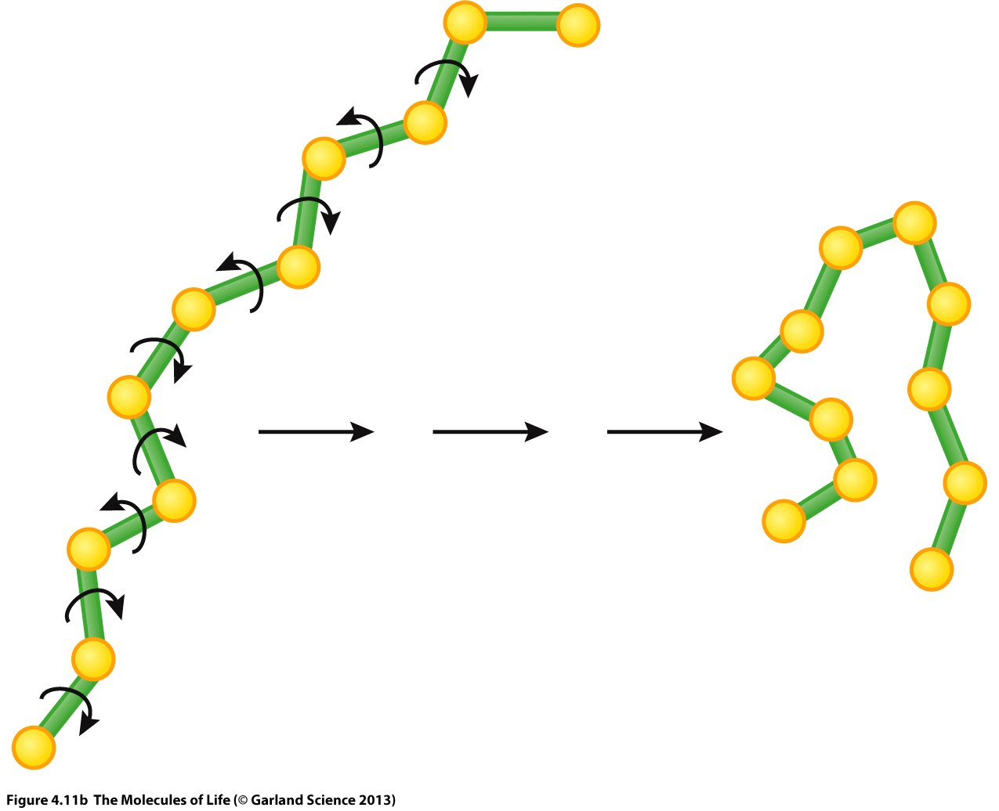
φ and ψ torsion angles are the only degrees of freedom for the backbone
3
2
1

Slide 19
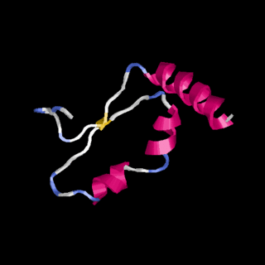

Slide 20
The protein folding problem
Consider a small protein with 100 residues.
Cyrus Levinthal calculated that, if each residue can assume three different conformations, the total number of structures would be 3¹⁰⁰, which is equal to 5 × 10⁴⁷. If it takes 10⁻¹³ s to convert one structure into another, the total search time would be 5 × 10⁴⁷ × 10⁻¹³ s, which is equal to 5 × 10³⁴ s, or 10²⁷ years i.e. longer than the age of the universe!
Clearly, it would take much too long for even a small protein to fold properly by randomly trying out all possible conformations.
The enormous difference between calculated and actual folding times is called Levinthal's paradox.

Slide 21
Important Questions on Protein Folding
How do proteins fold? i.e. How do proteins achieve their final folded structure?
How do proteins fold so fast? Most proteins fold within milliseconds.
Can we predict protein structures without experimentally solving them?
Can we design artificial proteins with unique functions to solve some of our problems?

Slide 22
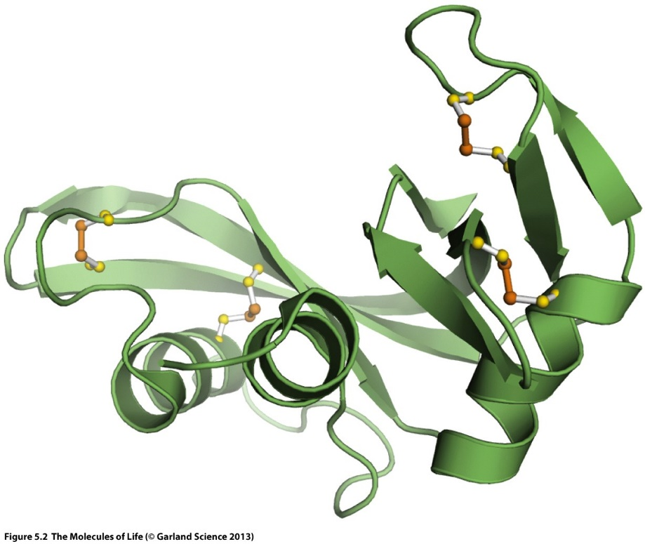
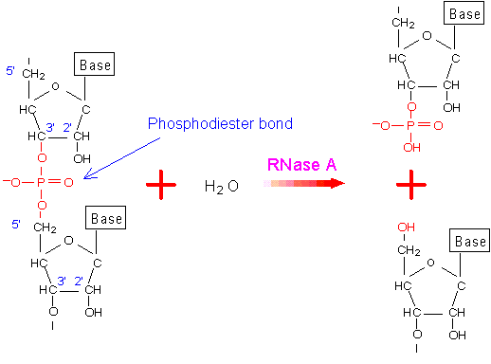
The 3D structure of a protein is encoded in its primary sequence: Anfinsen’s Experiment
Thermodynamic hypothesis of Protein Folding: The interactions between the atoms in a protein control the folding of the protein molecule into a well-defined three-dimensional structure.
In other words, the protein sequence contains enough information required for the proper folding of the protein into its functional three-dimensional structure.

Slide 23
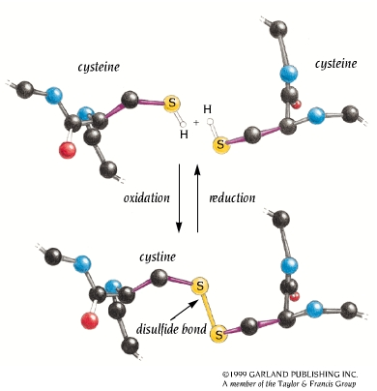

Slide 24
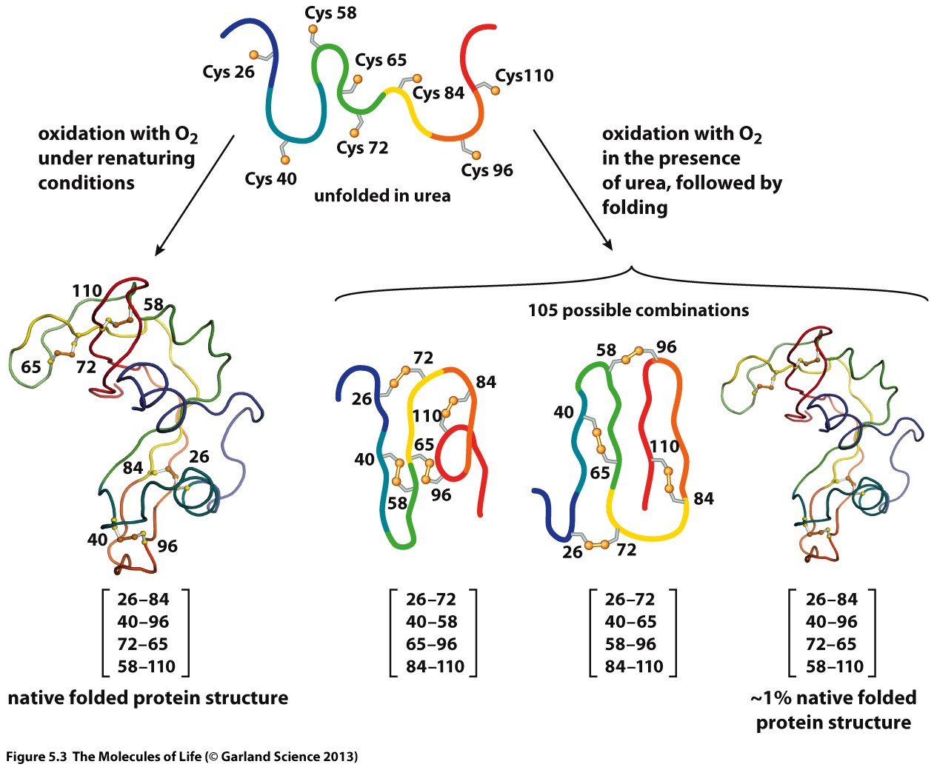
Anfinsen’s Experiment
BME beta mercapto ethanol

Slide 25
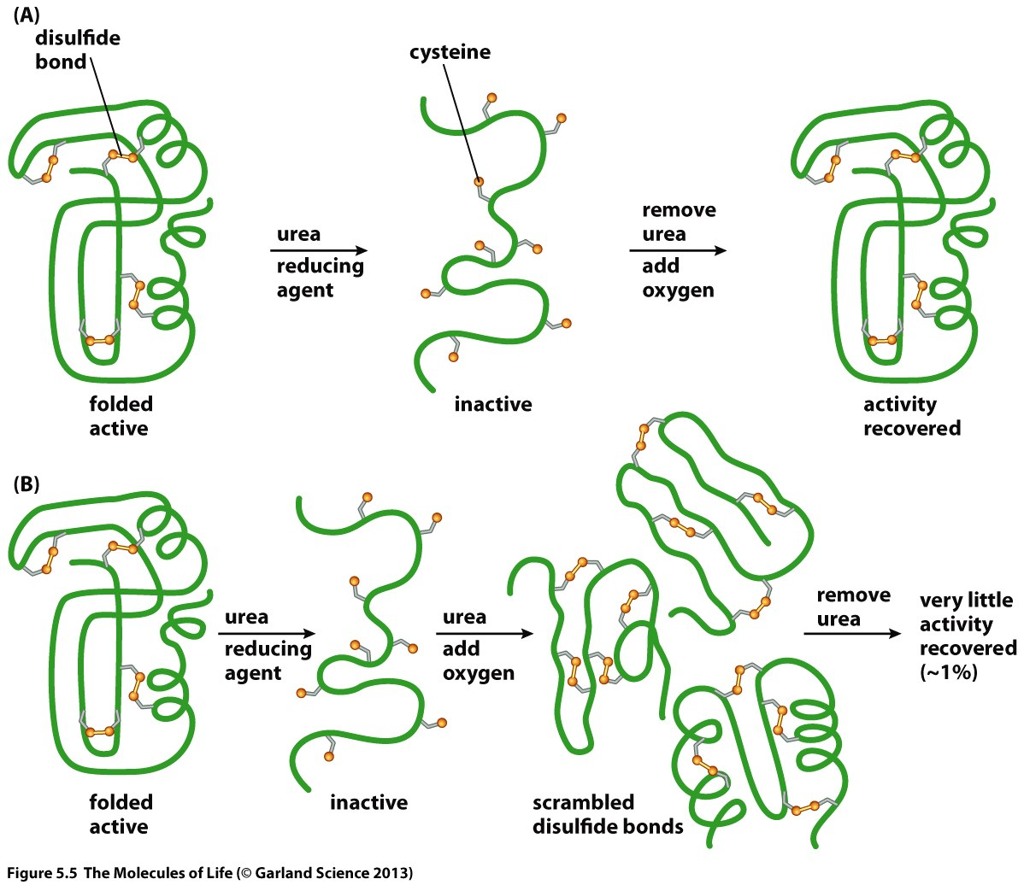
Anfinsen’s Experiment
If we understand HOW PROTEINS FOLD, we can predict their structure from sequence! Then we can design proteins with novel functions.

Slide 26
8 Cys
Select two at a time to form a disulphide bond
⁸C₂ * ⁶C₂ * ⁴C₂ * ²C₂ / 4! = 2520/4! = 105
# of ways to choose the first disulfide bond
It does not matter in which order the FOUR disulphide bonds are formed. # of permutations of FOUR disulfide bonds.

Slide 27
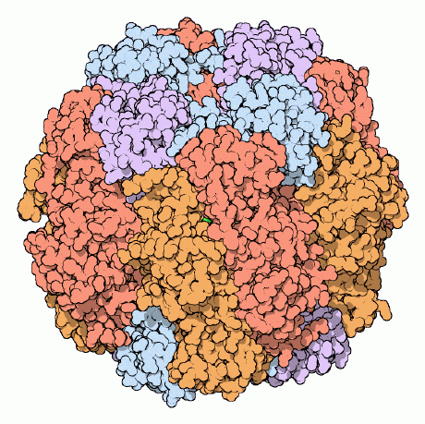


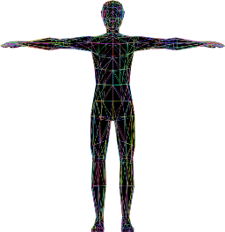
Important questions on Protein Folding
3. Can we predict protein structure from sequence
Anfinsen’s experiment demonstrates that a protein sequence encodes its structure.
Can we decipher this code? I.e. can we predict the structure of a protein from its primary sequence?
Prediction
Sequence
Structure
A | C | D | E
F | G | H | I
K | L | M | N
P | Q | R | S
T | V | W | Y
1,72,807
20 Amino Acids
300 AA/Protein
21,000 Proteins in Human body
200,000,000 Proteins in the world
Notes:
Average protein size in bacteria is 300 amino acids.
Average size of proteins in humans is 500 amino acids.
Total structures of proteins solved till date (Dec 2020) is 1,72,807

Slide 28
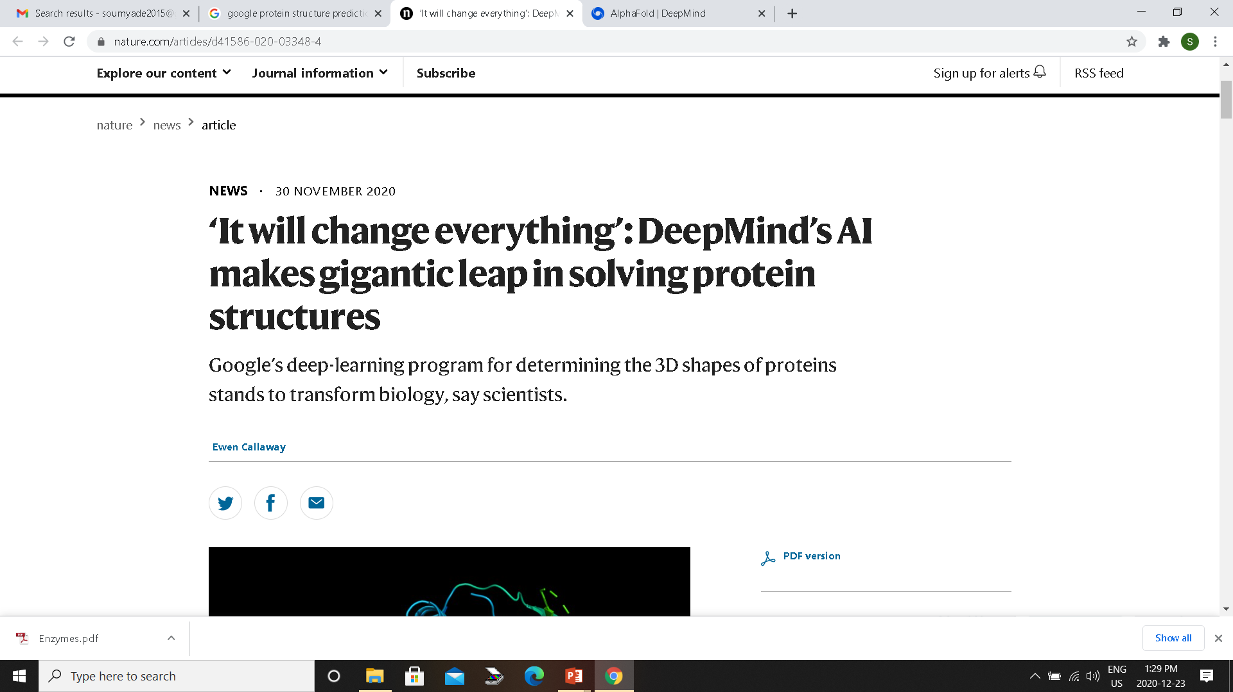
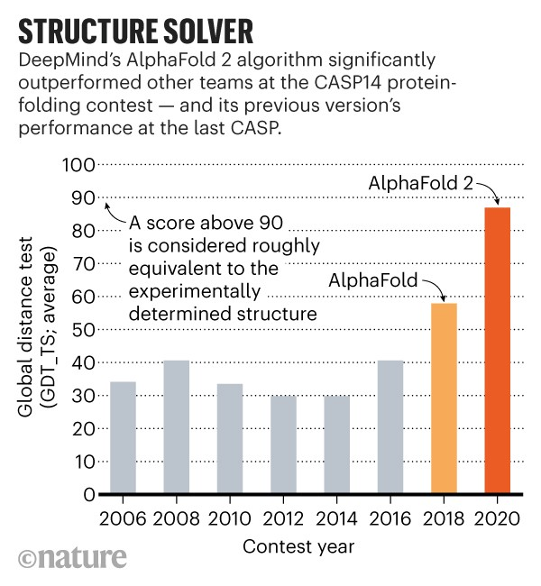
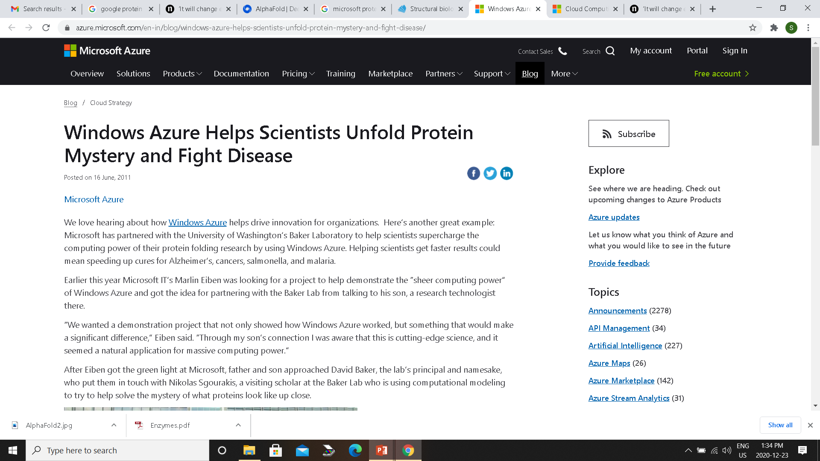
Important questions on Protein Folding
3. Can we predict protein structure from sequence
Anfinsen’s experiment demonstrates that a protein sequence encodes its structure.
Can we decipher this code? I.e. can we predict the structure of a protein from its primary sequence?
Prediction
Sequence
Structure

Slide 29
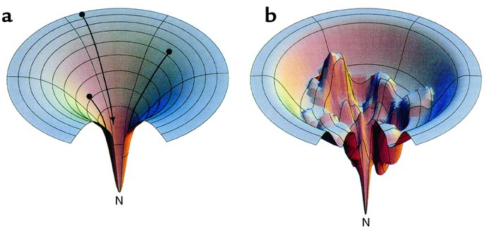
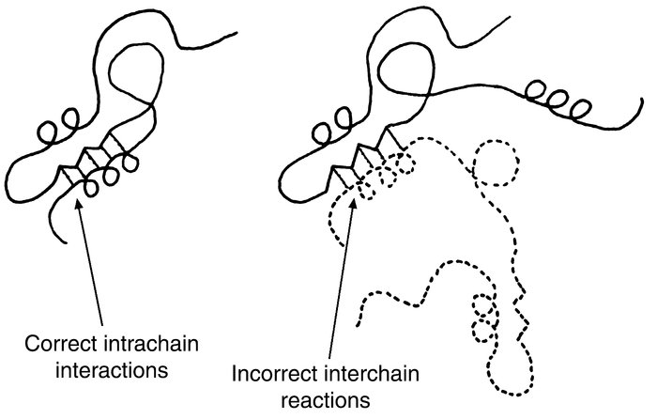
How Proteins Fold
Important interactions between amino acids:
Hydrophobic interactions
Hydrogen bonding interactions
Electrostatic interactions

Slide 30
How Proteins Fold
How do proteins fold? i.e. How do proteins achieve their final folded structure?
How do proteins fold so fast? Most proteins fold within milliseconds.
Protein Folding is a stochastic process i.e. not all conformations are sampled.
Proteins fold in small segments (~20 amino acids) independent of the rest. These folded segments or FOLDONS collapse to give the final structure.
Molecular Dynamics (MD) Simulations use physical laws to study protein folding
Animation of Protein Folding Funnel
https://www.youtube.com/watch?v=YANAso8Jxrk

Slide 31
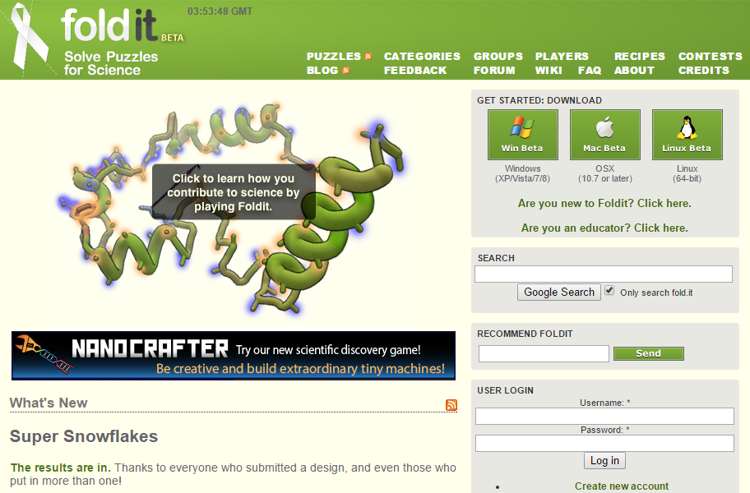
The protein folding game - Foldit
https://fold.it/portal/

Slide 32
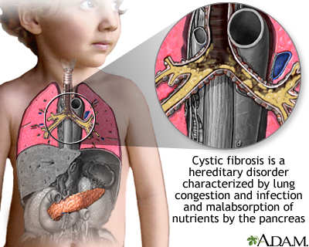
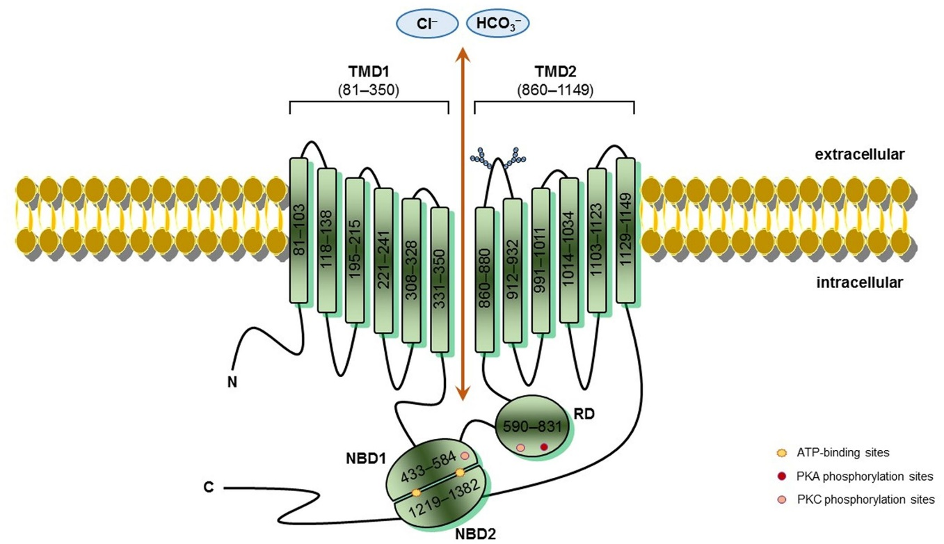
Protein misfolding leads to several diseases
Several diseases occur due to misfolding of proteins. Few examples:
Cystic Fibrosis: It results from the misfolding of Cystic Fibrosis Transmembrane Conductance Regulator (CFTR), a protein functioning as a chloride (Cl⁻) ion channel. The loss of CFTR function interferes with the body’s ability to efficiently secrete fluids and salts. It damages the lungs and digestive systems.
https://medlineplus.gov/ency/article/000107.htm
Frontiers in Pharmacology 2016 v-7, p-275

Slide 33
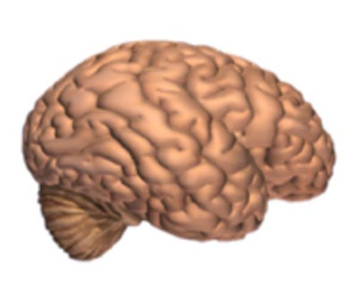
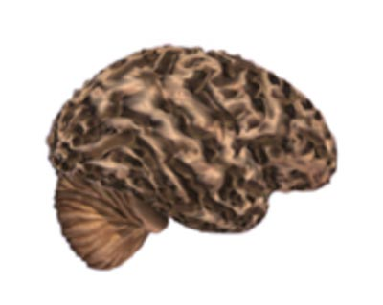
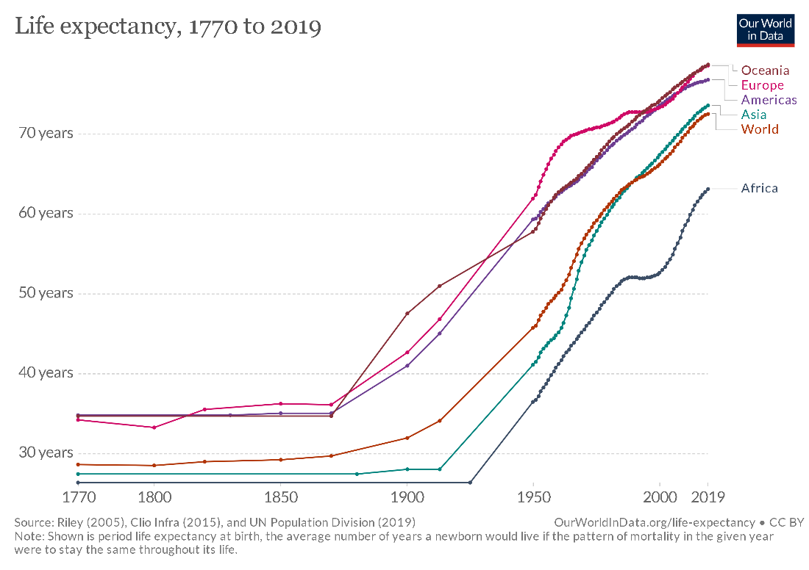
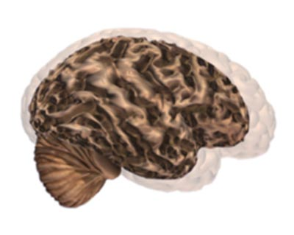
Protein misfolding leads to several diseases
Several diseases occur due to misfolding of proteins. Few examples:
Alzheimer’s Disease (AD): It results from the aggregation and precipitation of a peptide called amyloid-β (Aβ). AD is the most common form of progressive dementia in the elderly, and of neuro-degenerative diseases in general.
Normal Brain
Brain with AD
Comparison of the two Brains
www.alz.org

Slide 34
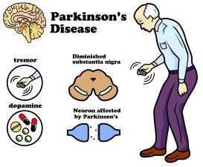
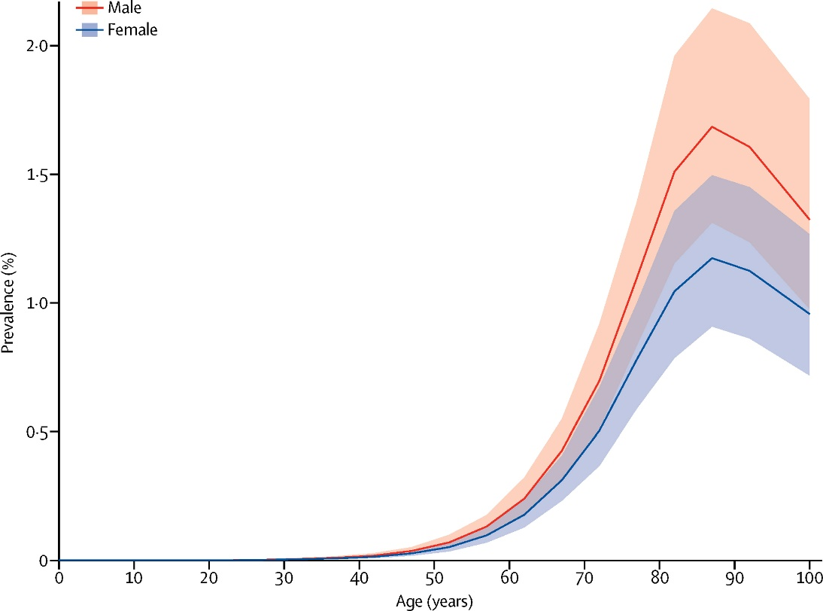
Protein misfolding leads to several diseases
Several diseases occur due to misfolding of proteins. Few examples:
Parkinson’s Disease (PD): It results from aggregation and precipitation of the protein α-synuclein. PD is a motor disorder common among the elderly (but can also hurt young people). It leads to shaking, stiffness, and difficulty with walking, balance, and coordination.
http://www.askdrray.com/parkinsons-disease-may-stopped/
Lancet Neurol 2018; 17: 939–53

Slide 35

Protein misfolding leads to several diseases
Several diseases occur due to misfolding of proteins. Few examples:
Creutzfeldt-Jakob Disease (CJD): It is caused by the aggregation and precipitation of the protein prion. It results in progressive motor dysfunction, cognitive impairment, and cerebral ataxia.
Higher order Aggregation
Aggregation
Misfolding
Nature Structural & Molecular Biology 19, 370-377 (2012)

Slide 36
Important Questions on Protein Folding
How do proteins fold? i.e. How do proteins achieve their final folded structure?
How do proteins fold so fast? Most proteins fold within milliseconds.
Can we predict protein structures without experimentally solving them?
Can we design artificial proteins with unique functions to solve some of our problems?

Slide 37

Protein Design Problem
Protein structure prediction
(for proteins found in Nature)
Q
M
S
R
A
L
T
V
K
Protein design
(for artificial proteins)

Slide 38


Slide 39


Designed Protein Targets the Conserved Stem Region of Influenza Hemagglutinin
Science 2011 32:816

Slide 40
Hierarchy of Protein Structure

Slide 41

Protein Molecules are Organized in a Structural Hierarchy
Primary
Secondary
Tertiary
Quaternary

Slide 42

Secondary Protein Structure
Characterized by main chain NH and CO groups participating in H-bonds
Beta Sheet
Alpha helix

Slide 43



Alpha Helix
Every 3.6 residues make one turn
The distance (pitch of helix) between two turns is 5.4 Å
The C=O of residue ‘n’ is hydrogen bonded to N-H of residue ‘n+4’
n n+1 n+2 n+3 n+4 n+5
Notes:
FIGURE 4-4 Models of the α helix, showing different aspects of its structure. (a) Ball-and-stick model showing the intrachain hydrogen bonds. The repeat unit is a single turn of the helix, 3.6 residues. (b) The α helix viewed from one end, looking down the longitudinal axis (derived from PDB ID 4TNC). Note the positions of the R groups, represented by purple spheres. This ball-and-stick model, which emphasizes the helical arrangement, gives the false impression that the helix is hollow, because the balls do not represent the van der Waals radii of the individual atoms. (c) As this space-filling model shows, the atoms in the center of the α helix are in very close contact. (d) Helical wheel projection of an α helix. This representation can be colored to identify surfaces with particular properties. The yellow residues, for example, could be hydrophobic and conform to an interface between the helix shown here and another part of the same or another polypeptide. The red and blue residues illustrate the potential for interaction of negatively and positively charged side chains separated by two residues in the helix.

Slide 44

The Alpha-Helix has a Dipole Moment
n n+1 n+2 n+3 n+4 n+5
Macro dipole
The dipoles of peptide units are aligned along the α helical axis
Notes:
FIGURE 4-5 Helix dipole. The electric dipole of a peptide bond (see Figure 4-2a) is transmitted along an α-helical segment through the intrachain hydrogen bonds, resulting in an overall helix dipole. In this illustration, the amino and carbonyl constituents of each peptide bond are indicated by + and – symbols, respectively. Non-hydrogen-bonded amino and carbonyl constituents of the peptide bonds near each end of the α-helical region are shown in red.

Slide 45

Alpha Helix: Right-handed or Left-handed?
Alpha helix can be – Right-handed or Left handed
BUT, left handed helix is not possible for L-amino acids due to close approach of the side chains and CO group.
Right handed – most commonly observed in proteins.

Slide 46


β-sheet
(Number of β-Strands are Involved)
β-sheet from several regions of the chain; Each β-strand, typically 5-10 residues long
α-helix: from one continuous region
H-bonds are perpendicular to strands
Notes:
The β conformation of polypeptide chains. These top and side views reveal the R groups extending out from the β sheet and emphasize the pleated shape described by the planes of the peptide bonds. (An alternative name for this structure is β-pleated sheet.) Hydrogen-bond cross-links between adjacent chains are also shown. The amino-terminal to carboxyl-terminal orientations of adjacent chains (arrows) can be the same or opposite, forming (a) an antiparallel β sheet or (b) a parallel β sheet.

Slide 47
Ramachandran Plot
α-Helix
β-Strand
Ψ (psi)
Φ (phi)

Slide 48


Parallel and Antiparallel β-sheet
β-pleated sheet: ‘pleated’ because side chains point up and down alternatively

Slide 49

Mixed β-sheet

Slide 50

Polypeptide Chains Fold into Several Domains
Fundamental unit of tertiary structure – DOMAIN
Domain: polypeptide chain or a part of polypeptide chain that can independently fold into a stable tertiary structure
Domains are also units of function
Tertiary structure refers to the spatial arrangement of amino acid residues that are far apart in the sequence and to the pattern of disulfide bonds.

Slide 52

Quaternary Structure
Proteins containing more than one polypeptide chain exhibit a fourth level of structural organization. Each polypeptide chain in such a protein is called a subunit. Quaternary structure refers to the spatial arrangement of subunits and the nature of their interactions.
The simplest quaternary structure is a dimer, consisting of two identical subunits.

Slide 53


Quaternary Structure (higher order)
The α2β2 tetramer of human haemoglobin. The structure of the two identical α subunits (red) is similar to but not identical with that of the two β subunits (yellow).
Complex Quaternary Structure. The coat of rhinovirus comprises 60 copies of each subunits

Slide 54
Methods to study protein structures
X-ray crystallography
Prof. Amit K Das
(http://www.iitkgp.ac.in/department/BT/faculty/bt-amitk)
Prof. Dibyendu Samanta
(http://iitkgp.ac.in/department/BS/faculty/bs-dibyendu.samanta)
Structure-guided protein engineering
NMR spectroscopy
Nuclear magnetic resonance (NMR) spectroscopy
Prof. Soumya De
(http://iitkgp.ac.in/department/BS/faculty/bs-somde)

Slide 55
Protein Structure, Function, Kinetics and Energetics
Books Followed:
How Proteins Work (Mike Williamson)
Introduction to protein structure (Carl Branden & John Tooze)
Biochemistry (Lubert Stryer)

